Slide 1
Synapse serverless SQL pool - Scenarios and best practices -
overall_1_132241972368228003 columns_1_132241972368228003
January 2022

Slide 2

Azure Synapse Analytics
Synapse Analytics
SaaS developer experiences
Experience
Synapse Analytics Studio
Platform
Multiple languages & clients suited to different workloads
MANAGEMENT
Languages & clients
VERSATILE, OPEN AND COMPATIBLE
SECURITY
Form Factors
Analytics runtimes available provisioned and serverless on-demand
SERVERLESS
DEDICATED
MONITORING
Analytics Runtimes
Synapse SQL for T-SQL batch, streaming and interactive processing
Spark for big data processing with Python, Scala, R and .NET
SQL
METASTORE
DATA INTEGRATION
Integrated platform services for, management, security, monitoring, and metastore
Azure
Data Lake Storage
Common Data Model
Enterprise Security
Optimized for Analytics
Focus of this training

Slide 3
Agenda
SQL pools
Recommended scenarios & patterns
Best practices
Q&A

Slide 4









Serverless Synapse SQL pool
Overview
An interactive query service that enables you to use standard T-SQL queries over Data Lake, CosmosDB, Dataverse.
Benefits
Use T-SQL language
Supports any tool or library that uses T-SQL to query data
Automatically synchronize tables from Spark pool
Querying multiple storages (Lake, CosmosDB)
Serverless experience
Auto Scale & Manage
Pay-per-use model
Fast
Automatic schema inference
Azure Data Studio
SSMS
Power BI
Sync table definitions
Spark pool
Serverless SQL pool
Read and write
data files
Azure Storage
CosmosDB
Notes:
- No infrastructure, no upfront cost, no resource reservation
Pay only for query execution (per data processed)
Autoscaling provides most efficient resource allocation to get your data as quick as possible
Full schema-on-read, automatic schema inference, variety of formats
Plug and play experience -> As soon as your Synapse workspace gets created you are able to execute queries on Serverless SQL pool endpoint, just like that.

Slide 5








Synapse SQL pools
SQL POOL
SQL POOL
Cache
Cache
Data Lake
Data Lake
Synapse Link
Dedicated SQL pools
Serverless SQL pools

Slide 6
Key concepts
Real-time – provides the latest version of data (no-ETL)
Interactive – provides sub-second response (Direct Query)
 | Interactive analytics | Non-interactive analytics
Real-time | Dedicated pools, Columnstore, materialized views, result set caching | Serverless pools over Data Lake, Cosmos Db
Non-real-time | Dedicated pools, ETL, materialized views, result set caching

Slide 7






Synapse SQL pools virtualization scenarios
External data
Benefits
(Near)real-time
Optimized access
No-ETL delay
Reporting layer
Serverless SQL pool

Slide 8




Serving layer for reporting tools
Data engineers refine shared data using various tools
Data is updated through the multiple layers (bronze, silver, gold)
Data analysts create reports using serverless SQL pools
Serverless SQL pools is a bridge between reporting tools and data
Reporting layer
Databricks
Apache Spark pools
Apache Spark pools
Serverless SQL pool
Bronze
Silver
Gold

Slide 9
Sharing data layer
Multiple workspaces sharing the same data
No data movement/imports
Serverless SQL pool
Serverless SQL pool
Serverless SQL pool
Serverless SQL pool
Serverless SQL pool

Slide 10





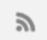

Synapse link – near real-time analytics
Transactional Store
Row store optimized for transactional operations
Analytical Store
Column store optimized for analytical queries
Machine learning
Operational
Data
Cloud-Native HTAP
Big data analytics
Auto-Sync
Azure Synapse Link
SQL
serverless
BI Dashboards
Dataverse
Azure Cosmos DB
Azure Synapse Analytics

Slide 11
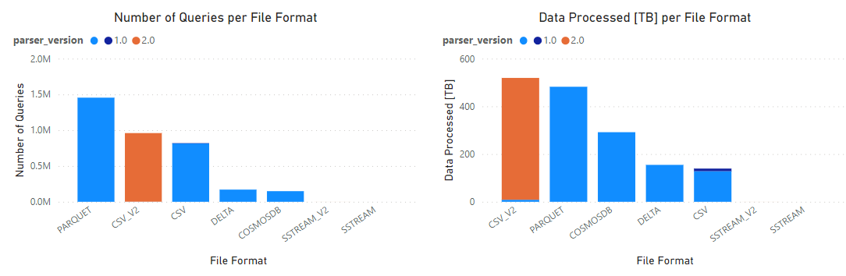
Weekly usage

Slide 12
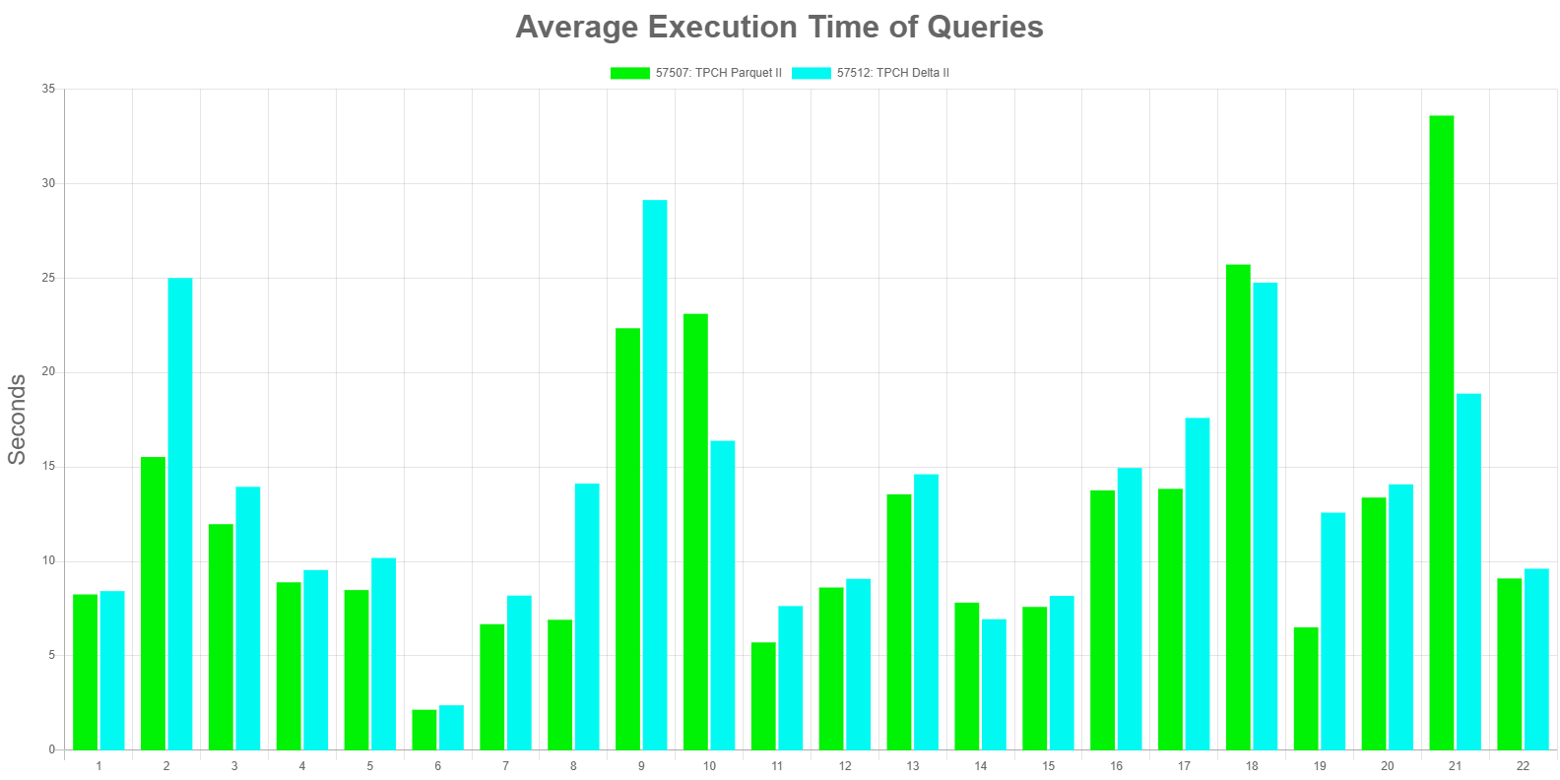
Delta performance

Slide 13
Best practices
How to optimize serverless SQL pool

Slide 14
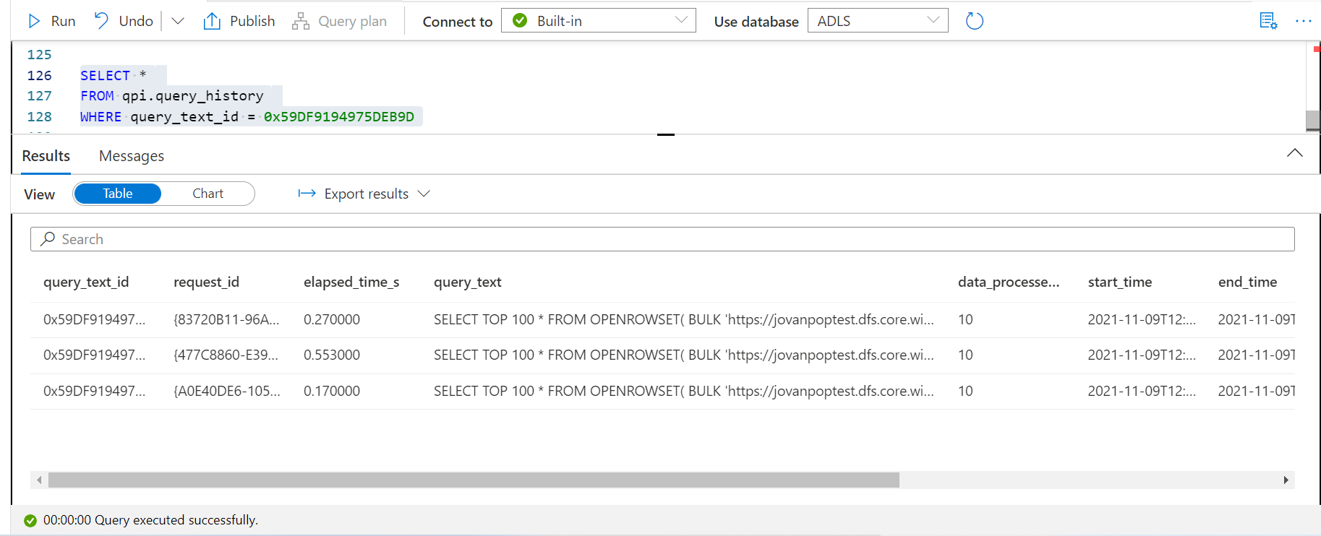
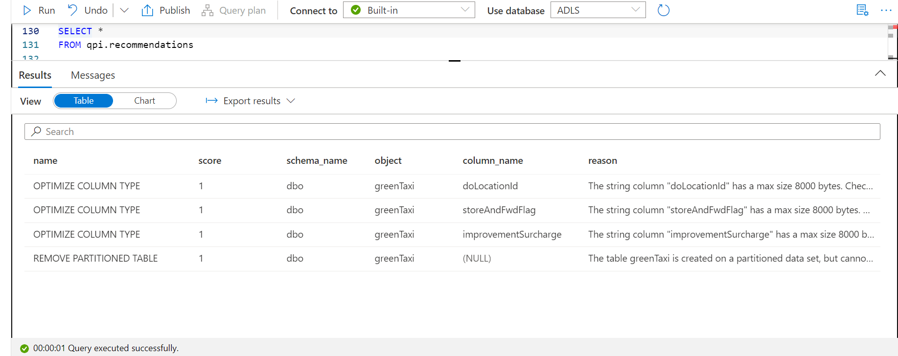
Logical data warehouse
Star schema
Optimize types
Minimize column types
Use proper types (avoid string)
Use partitioned views
Helper library: QPI

Slide 15
Optimize your architecture

Slide 16
Resource collocation
Make sure that Synapse workspace and data sources (ADLS/CosmosDb) are placed in the same region to avoid read latency
Make sure that clients and Synapse workspace are placed in the same region, or the region that is close to the client.
Use caching (Power BI import mode) for the large data sets or to ensure interactive analytics.

Slide 17
Multiple workspaces
Use multiple workspaces only if you are hitting resource limits
Create multiple workspaces to get more compute capacity
Serverless compute is close to 2000DWU with instant auto pause/resume
Drawbacks
Need to load-balance workload
Need to manually keep schema in Sync

Slide 18
Secure your solution
Use firewalls/private IP where necessary
Define RBAC roles for AAD identities what will use data, or SAS/CosmosDB keys.

Slide 19
Optimize storage

Slide 20
Optimize for cost and performance
List files
Eliminate partitions
Read files
Process data
Provide result set

Slide 21
Optimize for cost and performance
Optimize listing files
Move * down to lower levels in the path
OPENROWSET(BULK 'https://storageaccount/container/export/tables/*/*' ...) AS [r]
WHERE r.filepath(1) = 'customers'
OPENROWSET(BULK 'https://storageaccount/container/export/tables/customers/*' ...

Slide 22
Optimize for cost and performance
Eliminate files and folders before reading from storage
Utilize partition elimination to target specific files or folders (partitioned external tables support coming soon)
OPENROWSET(BULK 'https://storageaccount/container/orders/year=*/*' ...) AS [r]
WHERE r.filepath(1) = 2016

Slide 23
Optimize for cost and performance
Reduce amount of data for processing
Use columnar and compressed file format (Parquet instead of CSV and JSON)

Slide 24
Optimize for cost and performance
Reduce amount of data for processing
Use columnar and compressed file format (Parquet instead of CSV and JSON)
Use CETAS to prepare often used data (example: tables that are often joined)

Slide 25
Optimize for cost and performance
Reduce amount of data for processing
Use columnar and compressed file format (Parquet instead of CSV and JSON)
Use CETAS to prepare often used data (example: tables that are often joined)
Read only relevant columns (avoid *)
SELECT * FROM
OPENROWSET(BULK 'https://storageaccount/container/customers/*' ...) AS [r]
SELECT id, name FROM
OPENROWSET(BULK 'https://storageaccount/container/customers/*' ...) AS [r]

Slide 26
Optimize for cost and performance
Use the smallest data size that will accommodate the largest possible value
varchar and char instead of nvarchar and nchar
varchar of reasonable size instead of varchar(max)
char or nchar for fixed length values
smallest accommodating type, example: tinyint instead of bigint if largest value fits tinyint
SELECT * FROM
OPENROWSET(BULK 'https://storageaccount/...' ...)
WITH (
[country_code] VARCHAR (max),
[year] bigint
)AS [r]
SELECT * FROM
OPENROWSET(BULK 'https://storageaccount/...' ...)
WITH (
[country_code] VARCHAR (5),
[year] smallint
)AS [r]

Slide 27
Optimize for cost and performance
Use the smallest data size that will accommodate the largest possible value
varchar and char instead of nvarchar and nchar
varchar of reasonable size instead of varchar(max)
char or nchar for fixed length values
smallest accommodating type, example: tinyint instead of bigint if largest value fits tinyint
check inferred data types if schema inference is used
SELECT * FROM
OPENROWSET(BULK 'https://storageaccount/...' ...)
AS [r]
-- column [name] will be inferred as varchar(8000)
SELECT * FROM
OPENROWSET(BULK 'https://storageaccount/...' ...)
WITH (
[name] VARCHAR (50),
[year] smallint
)AS [r]
Notes:
more and more important as column is used in join, group by, where, order, distinct

Slide 28
Optimize for cost and performance
In the partitioned data sets CAST the FILEPATH() function to appropriate size to avoid default NVARCHAR(1024) type.
Use NVARCHAR type if the underlying text is UTF-16 encoded
Use VARCHAR type with UTF8 collation if the underlying text is UTF-8 encoded (for example Parquet)
Use Latin_General_100_BIN2_UTF8 collation on string partitioning columns or any other column where you will use filters (parquet) (soon to be obsolete)
Notes:
more and more important as column is used in join, group by, where, order, distinct

Slide 29
Optimize for cost and performance
Collocate your Azure Storage account and endpoint
Collocate consumer and endpoint
Colocate your CosmosDB analytical storage and serverless SQL pool
Prepare files for querying
Consider splitting single file into multiple files
Have balanced file sizes
Partition data by storing different partitions in different folders or file name patterns
Make sure Azure Storage is not stressed with other workloads
Use PARSER_VERSION 2.0 for querying CSV files
Create statistics for CSV files

Slide 30
Current limitations
Single file is processed with single node
Tens of thousands of files (slow file listing)
Maximum result set size ~200 GB
30 minutes timeout for distributed query execution
PARSER_VERSION 2.0 (CSV) has no LOB support
No autostats for statistics on CSV files (coming soon)

Slide 31
QnA

